Slide 1
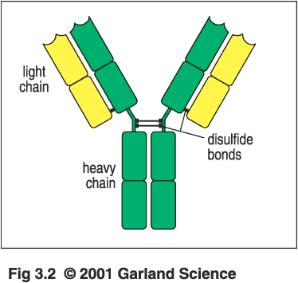
Antibody Structure and Function

Slide 2
Outline
Describe the basic structure of an immunoglobulin.
Describe the light and heavy chain structure
c. Explain electorphoresis patterns of Abs
d. Define hinge region.
d. Describe the difference between polyclonal and monoclonal.
f. Differentiate the five immunoglobulin classes found in humans.
g. Brief description of the antibody classes and their biological functions
h. Describe the kinetics of Ab responses following immunization

Slide 3
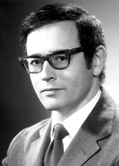
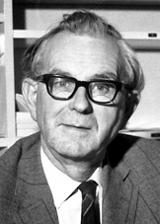
Nobel prize winner, 1972
Structure of antibody
Gerald Edelman
(USA)
Rodney porter
(England)

Slide 4
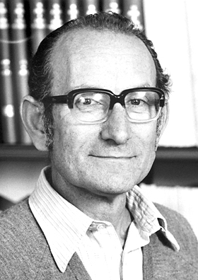
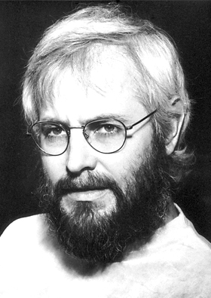
Noble prize winner, 1984 Monoclonal antibodies
George Kohler
Germany
Cezar Milstein
Germany

Slide 5
Serum and plasma
Serum
Blood
Plasma
Clot
Antibodies exist in serum or plasma
Blood +
anticoagulant
Cells

Slide 6
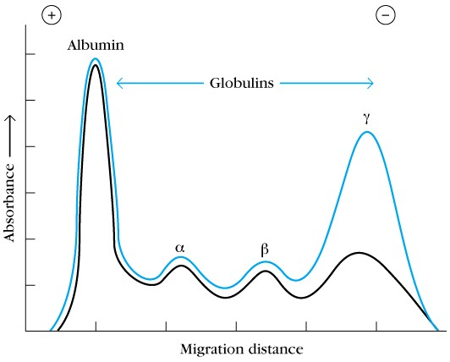
.immunized rabbits with ovalbumin
-serum electrophoresis
-serum was incubated with ovalbulin
and also electorphoresed (serum minus the Abs)
-Abs exist in globulins
Treated with ovalbumin (to absorb antibody)

Slide 7
Characterizing chains
Albumin
Broad peak of γ = heterogenous proteins
Protein concentration
α1
α2
β
γ
+
-
normal
Narrow peak of γ = homogenous proteins
Protein concentration
-
Bence-Jones proteins in urine of multiple
myeloma pts. = dimers of immunoglobulin
light chains, κ or λ
+
multiple myeloma

Slide 8
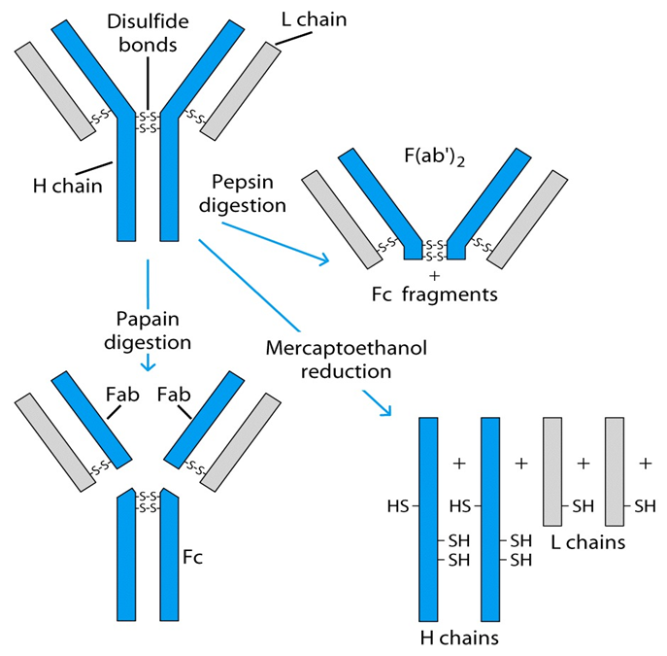

Slide 9
Treatment with proteolytic enzyme, papain,
resulted in three fragments:
2 capable of Ag rx (fragment antigen binding)
1 could be crystallized (fragment- crystallizable)
-Fab specifically bind antigen, univalent (can’t ppt)
one binding site each, identical to each other
-Fc crystallizable (thus homogenous) can’t bind Ag responsible for biological activity of molecule after Ag bound to Fab portions
Treatment with mercaptoethanol = 4 chains
(mercaptoethanol breaks S-S bonds)
All immunoglobulins basic unit consisting of 4 polypeptides i.e. 2 H, 2 L
-2 chains = 53,000 daltons
2 chains = 22,000 daltons
Treatment with proteolytic enzyme pepsin: resulted in bivalent antigen-binding fragments (F(ab')2), and additional small protein fragments.

Slide 10
Immunologic analysis of immunoglobulins
L chain
-All species have two major classes of L chains i.e. κ, λ
-An individual of species produces both types; ratio of
κ : λ varies by species (e.g. mouse 95%κ ; human
60% κ)
-In any Ig molecule, both L chains = either κ or λ
H chain:
-5 types of H chain exist in all species
-Ig consist of 5 classes (isotypes) differ in structure of H chains
-H chains among isotypes differ serologically, CHO
content, size & biological function

Slide 11
H chain confers unique biologic properties of molecule e.g.
half life, receptor binding, Complement activation
Immunoglobulin isotype
Heavy chain
IgM μ
IgG γ
IgA α
IgD δ
IgE ε
-Individual of species produces all H chains, in proportion
characteristic for species
-Ab molecule H chains are identical ( i.e., 2ε, 2δ etc.)

Slide 12
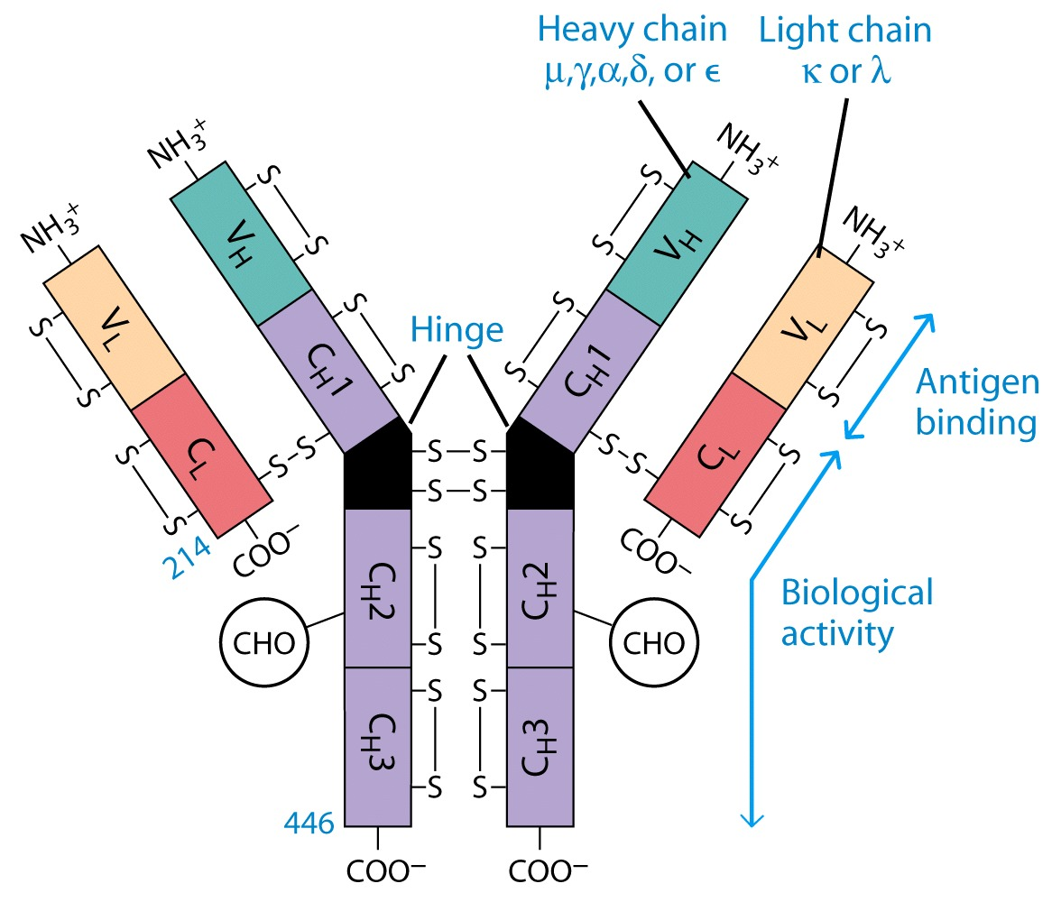

Slide 13
Ig domains
Ig domains: Intrachain S-S bonds form loops within the chain that create the anti-parallel β–pleated sheet
Each L chain has 2 domains
each H chain has 4 or 5 domains
VL, VH and CL, CH1,CH2, CH3 and CH4
VH-VL domain
CH1-CL, CH2-CH2, CH3-CH3 domains

Slide 14
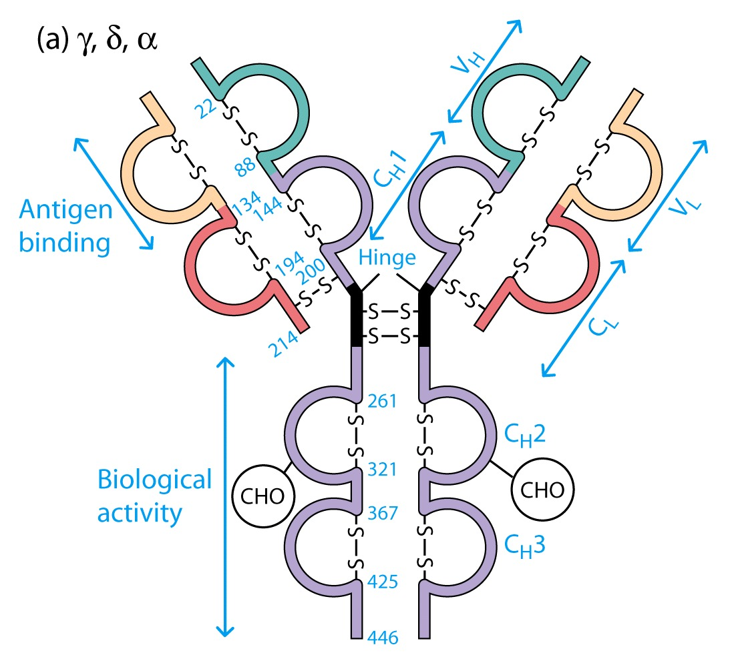
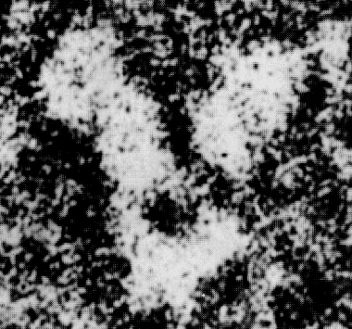

Slide 15
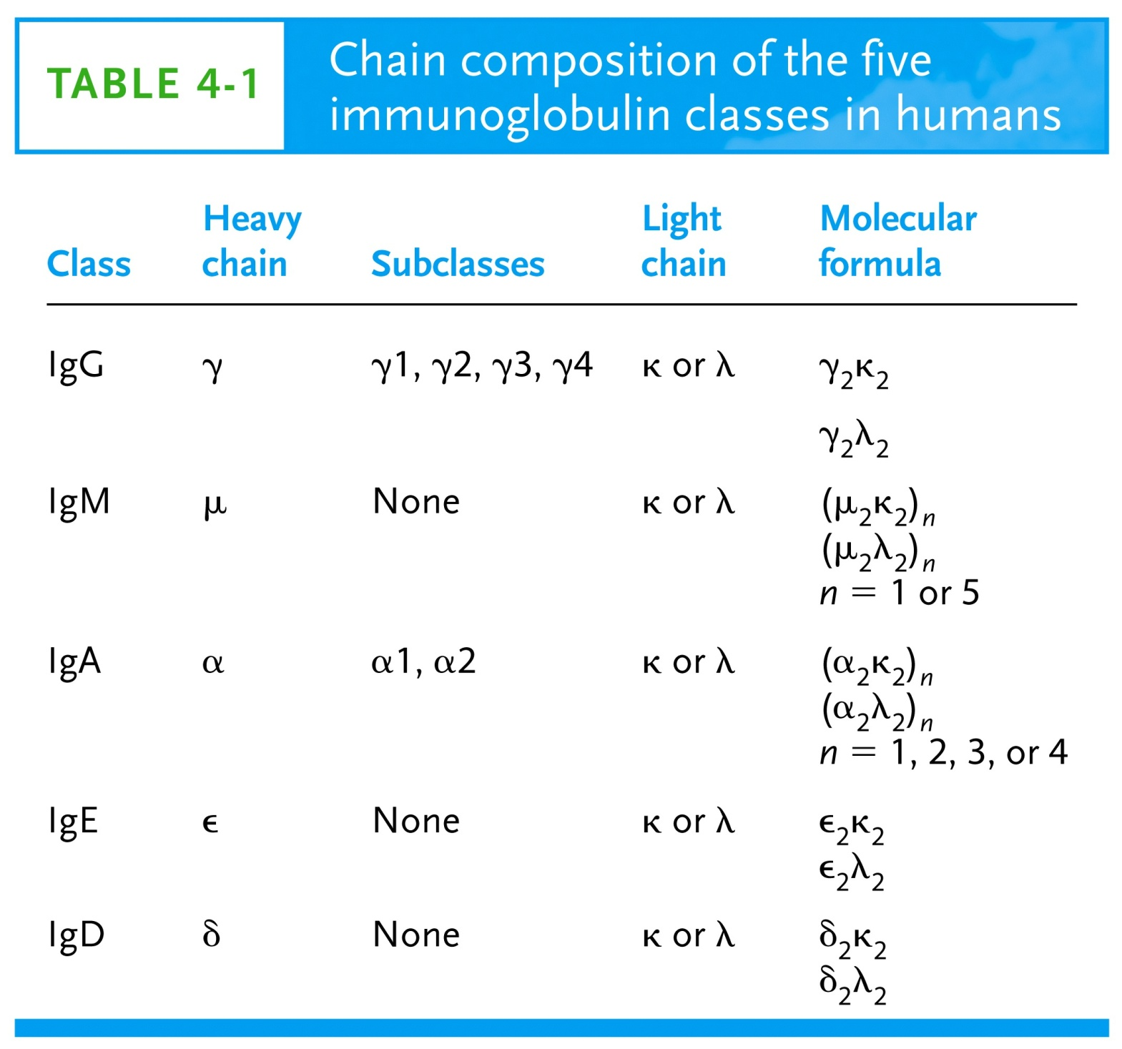

Slide 16
V region
-110 N terminal a.a of both L and H chains
-3 Hypervariable regions or complementarity determining regions CDR 1, 2 and 3 show greatest amount of variability: participate in Ag-Ab rxn
-Framework region: the less variable stretches between CDRs
-The CDR of both L and H are brought together in the tertiary S. to make the binding site which is complementary to the epitope.

Slide 17
Characteristics of hinge region
Immunoglobulins IgG, IgA, IgD contain hinge between C_{H}1 & C_{H}2.
Both IgM and IgE lack a hinge region but each contains an extra heavy-chain domain CH3
No homology between a.a sequence of hinge & heavy chains
a.a sequence differs with different classes
Comprised of many cysteine and proline residues
Cysteine involved in formation of interchain disulfide bonds
Proline prevents folding in a globular structure, allowing flexibility between
two Fab arms of the Y-shaped antibody; allows open & close to accommodate
binding to two epitopes.

Slide 18
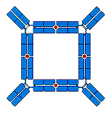
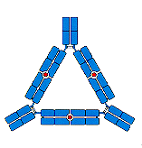
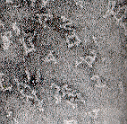

Hinge region
a.a sequence unique for each class
& subclass
Angle = 90⁰
Angle = 60⁰
Angle = 0º

Slide 19
Function of Fab region
Binding the Ag
Functions of Fc region
Activation of complement system
Opsonization : the phagocytes have FcR
Cross placenta: brample R for Fc

Slide 20
Ag-Ab RX
Bonds between Ag and Ab
H-bonds
Hydrophobic bonds
Ionic bonds
Van der Waals forces
Binding
-2 Abs with 2 specificities have different a.a sequences in the V
-2 Abs with different a.a sequences have specificity for the same epitope but have different affinities
-A specific Ab against one hapten may react with other Ag e.g DNP and sRBCs (redundancy).

Slide 21
Antibodies Act As Immunogens
Antigenic Determinants on Abs Fall in 3 Categories
  Isotypic
  Allotypic
  Idiotypic
Isotypic
  Constant Region Of Ab
  If you inject Ab in a different species Anti-Isotype is generated
  within the same species, No Anti-isotype

Slide 22
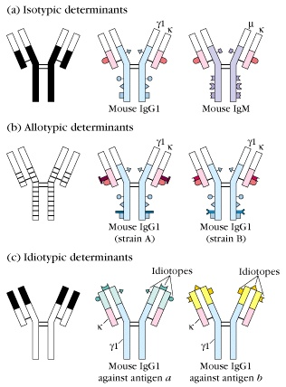
Antibodies are good antigens

Slide 23
Antibodies Act As Immunogens
Allotype
  Even though same isotypes within one species small differences (1-4 a.a) arise in different individuals (form of polymorphism)
  If injected with such Ab, you generate anti-allotype Ab
    During pregnancy
    Blood transfusion

Slide 24
Antibodies Act As Immunogens
Idiotype
  Unique V_{H} AND V_{L} binds antigen but can also behave as antigenic determinant
If you inject a monoclonal antibody into a genetically identical recipient then anti-idiotypic antibodies are generated
No anti-isotypic and no anti-allotypic Abs will be generated

Slide 25
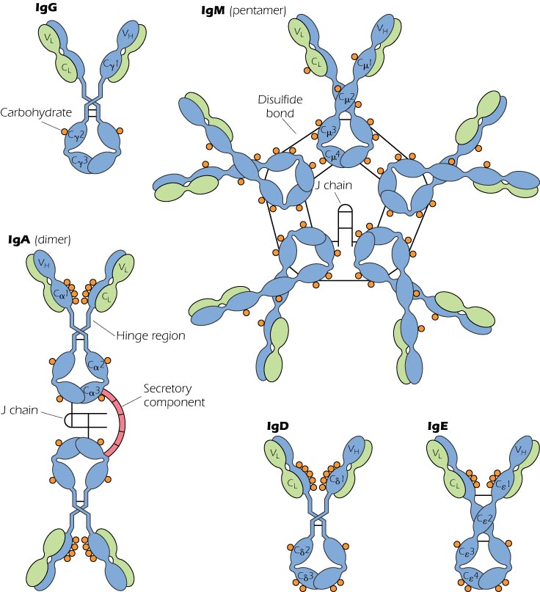
Ig classes

Slide 26
Biological Activities of IgG

Slide 27
Ig subclasses
  -IgG1,2,3,4 (decreasing serum concentration)
  -IgG2 does not cross placenta
  -IgG4 does not activate complement
  IgG4 cannot bind phagocytes
  IgG1, 2 and IgG3 High affinity for FcR on phagocytic cells, good for opsonization

Slide 28
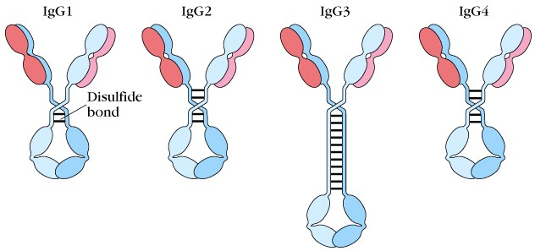
IgG- most common in serum; monomeric
four subclasses
Slight differences in structure; significant
differences in function

Slide 29
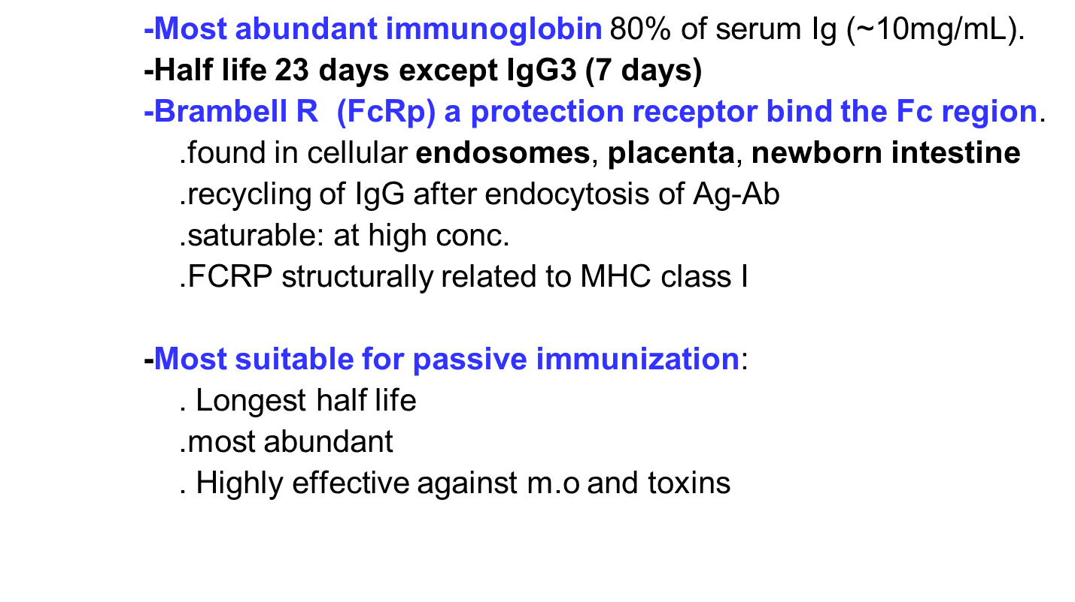

Slide 30
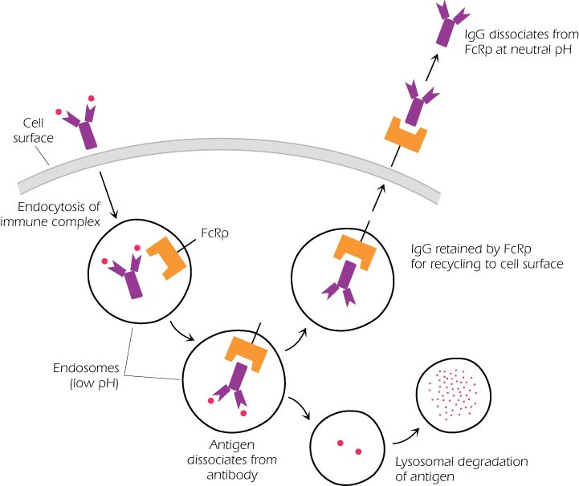
recycling of IgG after endocytosis of Ag-Ab

Slide 31
Kinetics of Ab responses following immunization
Primary Immune Response
Can be divided into several phases:
1. latent or lag period:
1-2 weeks before Ab is detectable in the serum
2. Exponential phase: the conc. Of Ab in the serum increases exponentially
3. steady state phase:
production and degradation of Ab are balanced
4. Declining phase
the immune system starts to shut down
The first Ab detected in primary responses is IgM
The immunized individual may be left with a pool of long-lived memory cells

Slide 32
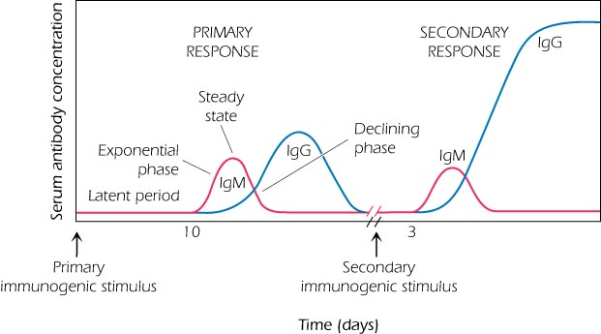
IgG Predominate in secondary i.r

Slide 33
Secondary immune response
Immune respone after a second exposure to the same Ag.
-The lag phase is shorter
-The magnitude is much greater
-prolonged declining phase (months or even years).
-Class switching: different classes of Ig with the same Ag specificity appear
-Affinity maturation: the binding strength of the Abs with the Ag increases
IgG predominates but IgM also persist

Slide 34
Passage through placenta
-IgG is the only Ig (except IgG2) cross placenta
-facilitated by expression of FcRp on placental cells
-3-4 months of pregnancy: rapid increase in maternal IgG.
-During the 5th month the fetus begins to synthesize IgM and trace IgA.
-4 months after birth, the infant begins to synthesize its own IgG
-The FcRp is superexpressed in the intestinal tissue of neonates

Slide 35
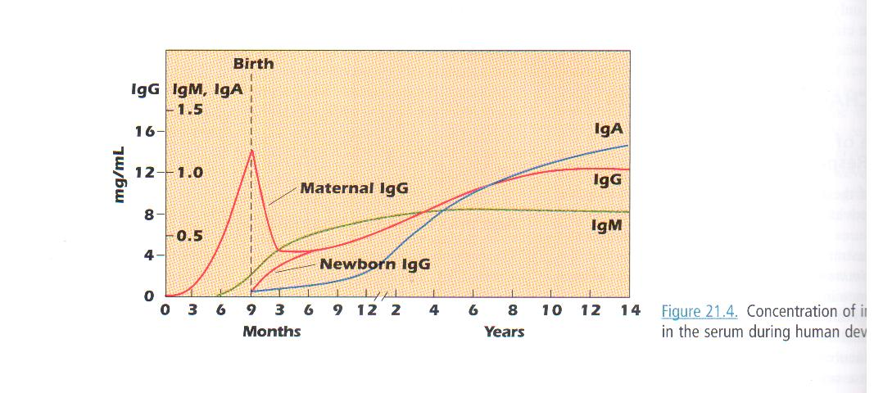

Slide 36
Agglutination:
IgG cause Clumping of particulate (insoluble) Ags.
Insoluble Ag-Ab complexes are easily phagocytosed and destroyed
. Precipitation: reaction of soluble multivalent Ag with Ab
Aggregation of IgG:
precipitation with alcohol (purification of IgG)
heating at 56⁰C for 10 min (inactivate complement)

Slide 37
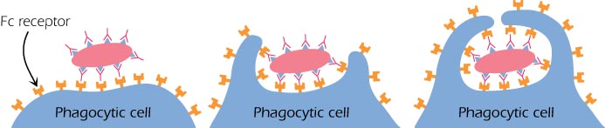
Opsonization: facilitation of phagocytosis due to presence of FcR on phagocytes
Pathogen-IgG-Fc….FcR-phagocyte
Ab-dependent Cell-mediated cytotoxicity ADCC
NK cells-FcR……FcR-IgG-Tumor cell or m.o
NK release cytotoxic substances
Activation of Complement system: IgG4 does not activate C

Slide 38
Neutralization of toxins and Viruses
neutralization of tetanus and botulinus, snake venum and viruses
Immobilization of Bac
IgG react with flagella or cilia arrest the movement of bac and prevent their spread

Slide 39
IgM
Structure
  2 types: monomeric or membrane IgM expressed on
  B-cells as BCR
  Pentameric IgM version is secreted
  -5-10% of serum immunoglobulin (1.5mg/mL)
  -High M.W (900 KD) and 19S
  -Has an extra CH domain
  -High valence Ig (10 theoretical) but 5 due to steric hindrance.
  -The 5 monomers joined by a small chain (J chain) which is synthesized in the B cells. Mild treatment with reducing agents e.g mercaptoethanol break the J chain

Slide 40

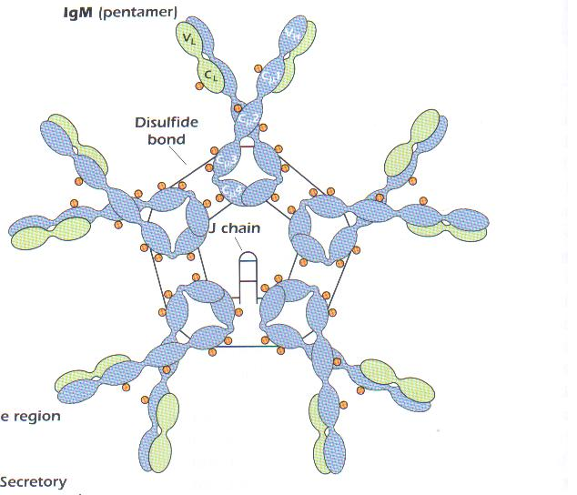

Slide 41
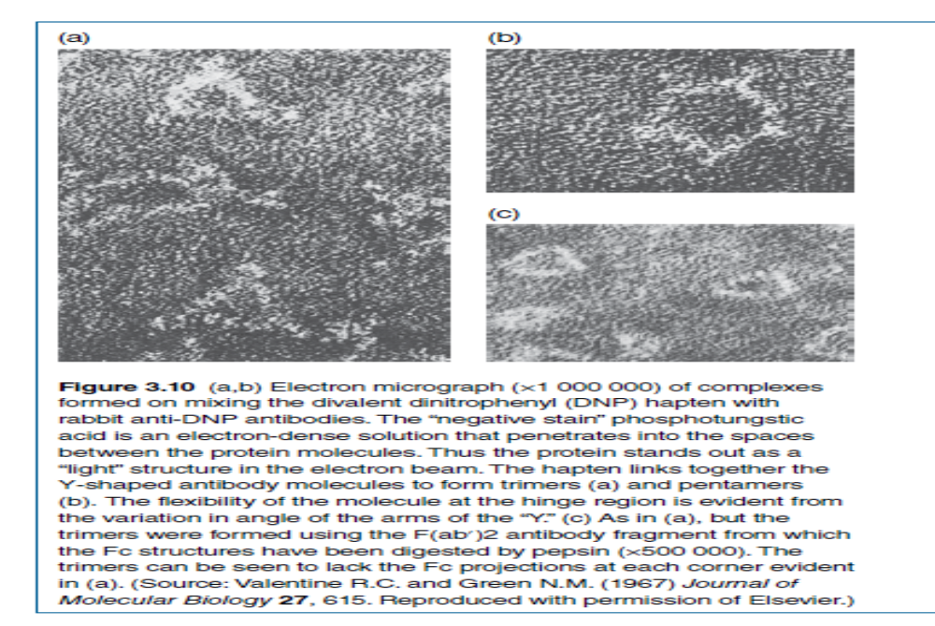

Slide 42
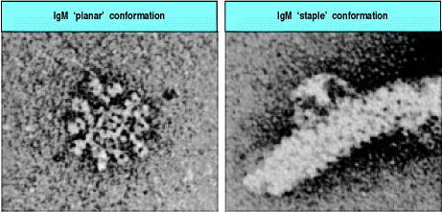

Slide 43
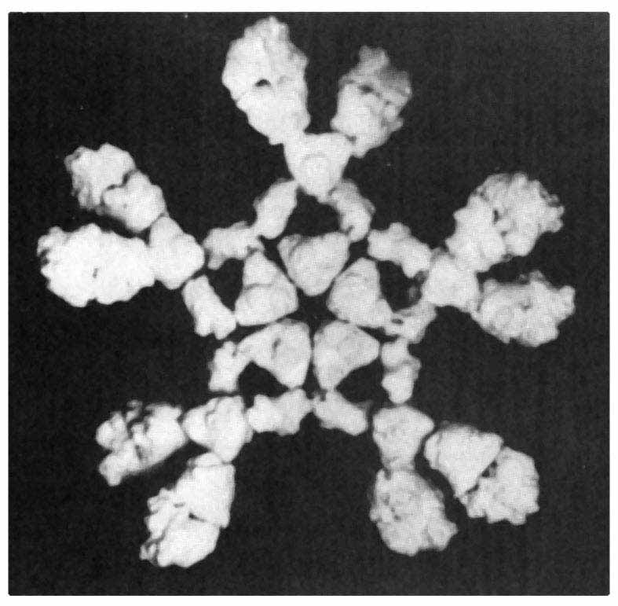
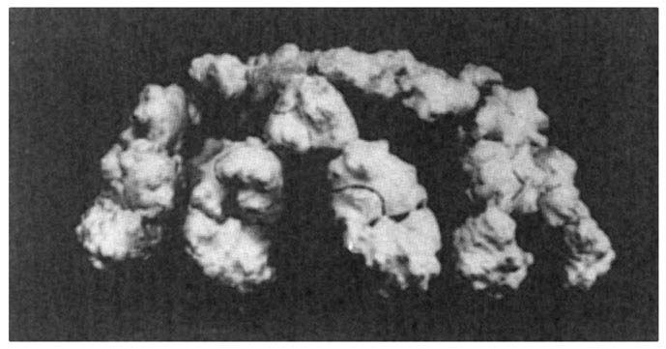
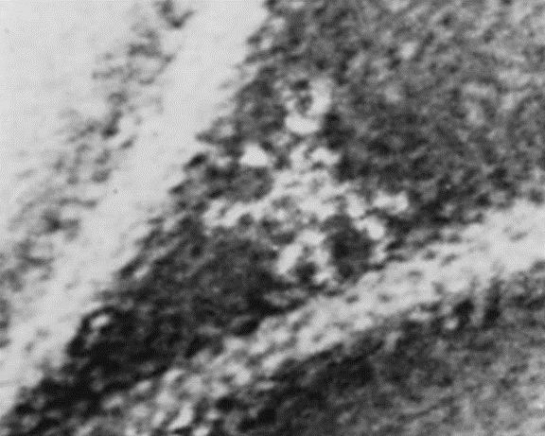
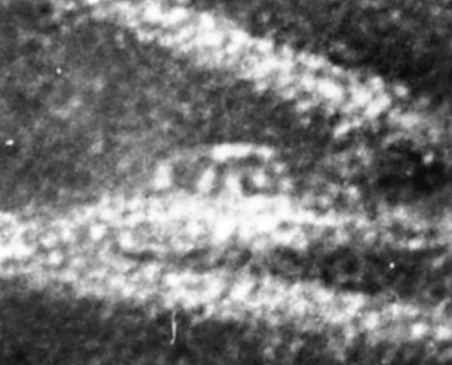
Antigen-induced conformational changes in IgM
Planar or ‘Starfish’ conformation found in solution.
Does not fix complement
Staple or ‘crab’ conformation of IgM
Conformation change induced by binding to antigen.
Efficient at fixing complement

Slide 44
  Biological activities
  Found predominately in the intravascular spaces.
  The half life is 5 days
  First Ig of primary immune response
  provide an early line of defense against bacterial infection. Elevated levels of IgM indicates either current or recent infection
  -Unlike IgG, IgM do not cross placenta and the only Ig synthesized in the fetus, elevated level of IgM indicates congenital or perinatal infection.

Slide 45
Due to their pentameric structure, IgM are very efficient in agglutination and suited to combat Ags with repetitive epitopes like LPS (T-indep. Ags).
Include the natural occuring Abs against the RBCs Ags of the ABO system. So without known prior immunization, people with group O have isohemagglutinins of anti-A and Anti-b Ags.
does not cause hemolytic diseases of the newborn

Slide 46
IgA
Structure
Monomeric IgA has no known function and a half life of 5.5 days and present mainly in serum
Dimeric or secreted sIgA
  Has 2 subclasses IgA1 (93%) and IgA2 (7%).
  sIgA: dimer + J-chain polyptetide + secretory component (Poly IgR

Slide 47
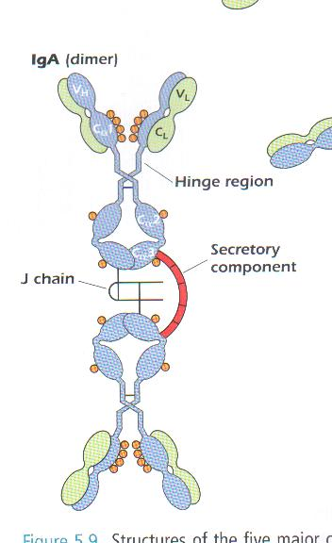

Slide 48
  Biological activity
  Predominant Ig in secretions
    Milk, saliva, tears, mucus
  -Secretion: The plasma cells synthesizing IgA molecules and the J chains to form the dimers. The plasma cells are located in the lamina propria that lies below the basement mem of many surface epithelia (e.g parotid gland, intestinal villi, tear glands, lactating breast, bronchial mucosa).
  -The secretory component protect the sIgA from proteases. It also transport pentameric IgM to mucosal surfaces in small amounts.

Slide 49
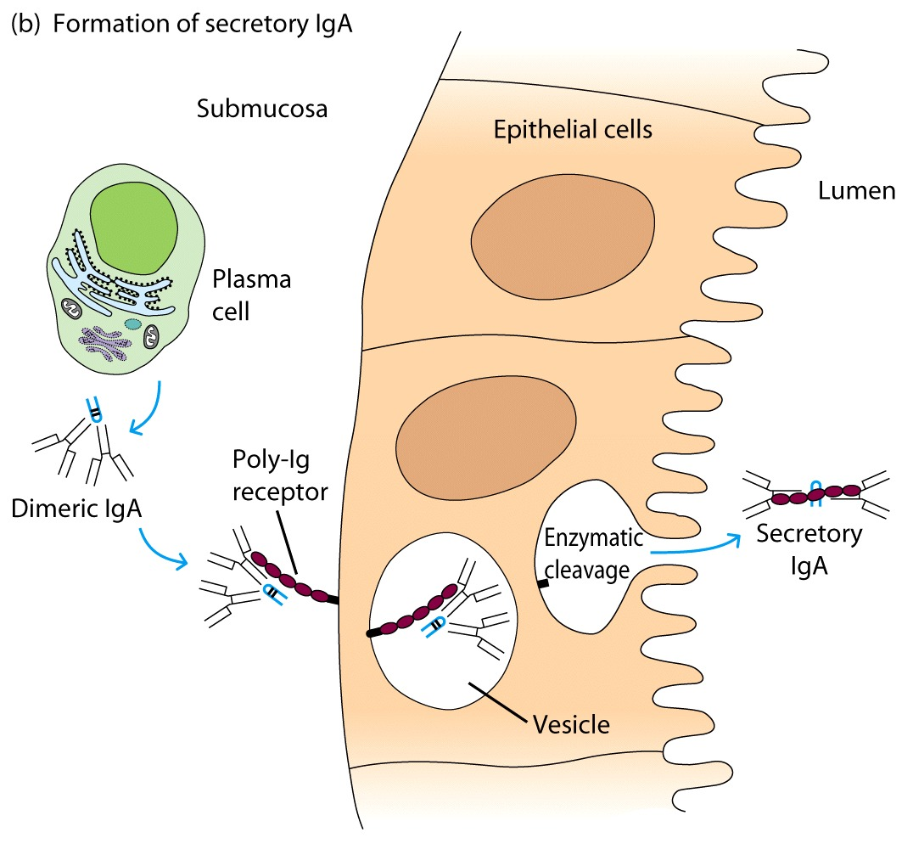
IgA Antibody Transport Across Cell (Transcytosis)

Slide 50
IgA do not fix complement
Possess bacteriacidal activity against gram negative bac but only in the presence of lysozyme.
Is an efficient agglutinating Ab and against viruses prevent them from entering host cells.
.

Slide 51
Antibody IgE
  Very low serum concentration, 0.3μg/mL
  and the least half life (2 days).
  Participate in immediate hypersensitivities reactions. Ex. Asthma, anaphylaxis, hives
Binds Mast Cells and Blood Basophils thru FcεR
Binding causes degranulation (Histamine Release)

Slide 52
IgD
IgD is co-expressed on mature B-cells as a surface receptor along with IgM. As a surface receptor, it plays a role in establishing immune tolerance and stimulates B-cells to mature into plasma cells.
Secreted IgD mainly is present in the upper respiratory tract and binds to respiratory pathogens to prevent infections.
highly susceptible to degradation (Low serum concentrations, ~30μg/mL).
Half life is 2.8 days

